Slide 1
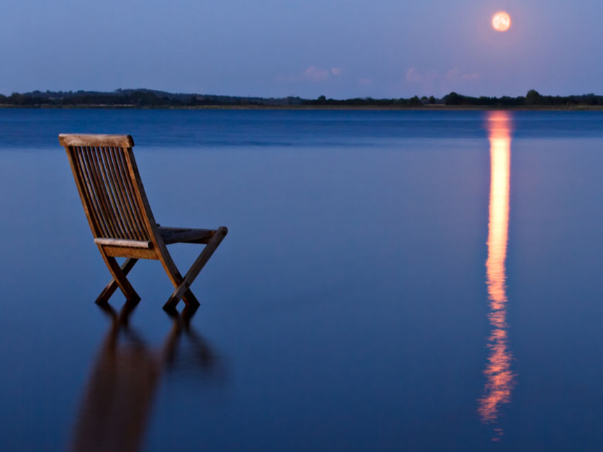
Be still and know… Psalm 46

Slide 2
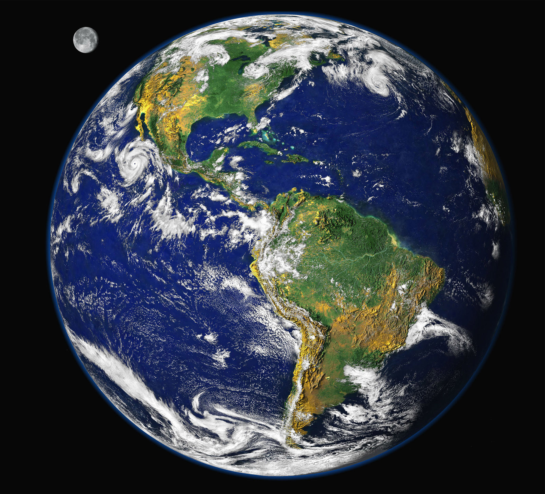
I am God
Elohim - creation, power

Slide 3
Psalm 46 New International Version
1 God is our refuge and strength,
an ever-present help in trouble.
2 Therefore we will not fear, though the earth give way
and the mountains fall into the heart of the sea,
3 though its waters roar and foam and the mountains quake with their surging

Slide 4
Psalm 46 New International Version
4 There is a river whose streams make glad the city of God,
the holy place where the Most High dwells.
5 God is within her, she will not fall;
God will help her at break of day.
6 Nations are in uproar, kingdoms fall;
he lifts his voice, the earth melts.
7 The Lord Almighty is with us;
The God of Jacob is our fortress.

Slide 5
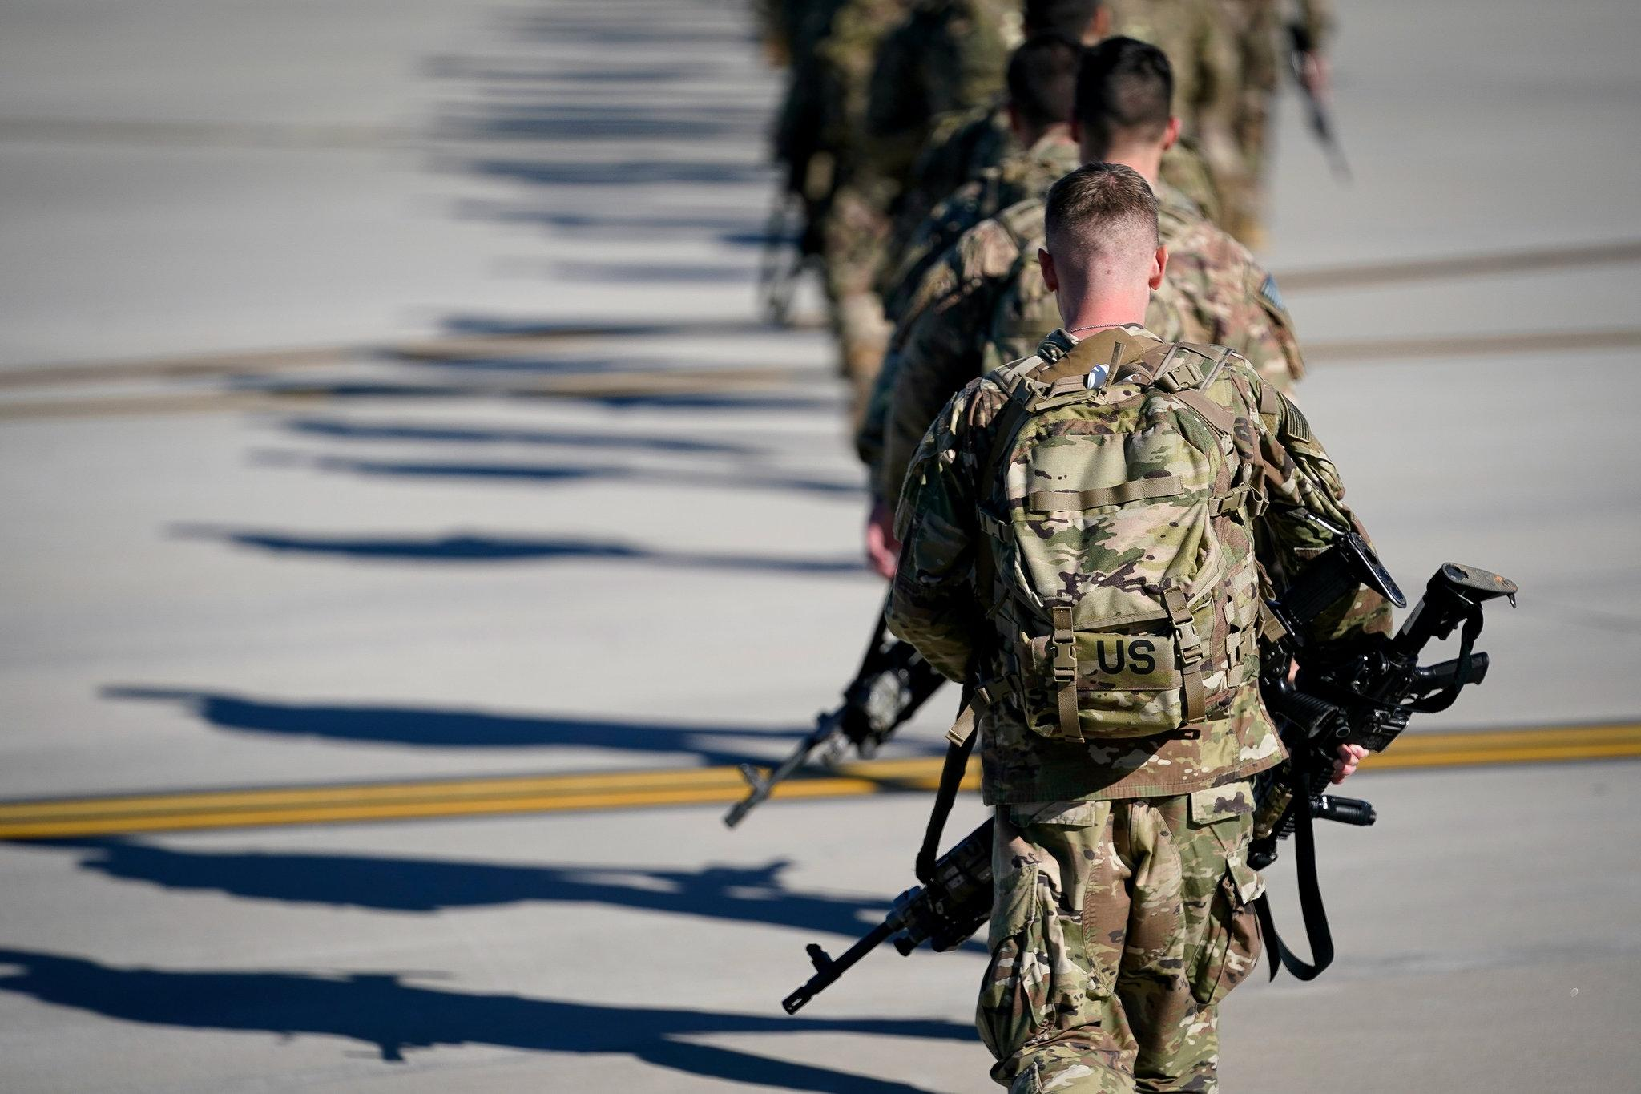
I am God
Elohim - creation, power
Ultimate control over all

Slide 6
Psalm 46 New International Version
8 Come and see what the Lord has done, the desolations he has brought on the earth.
9 He makes wars cease to the ends of the earth.
He breaks the bow and shatters the spear;
he burns the shields with fire.

Slide 7
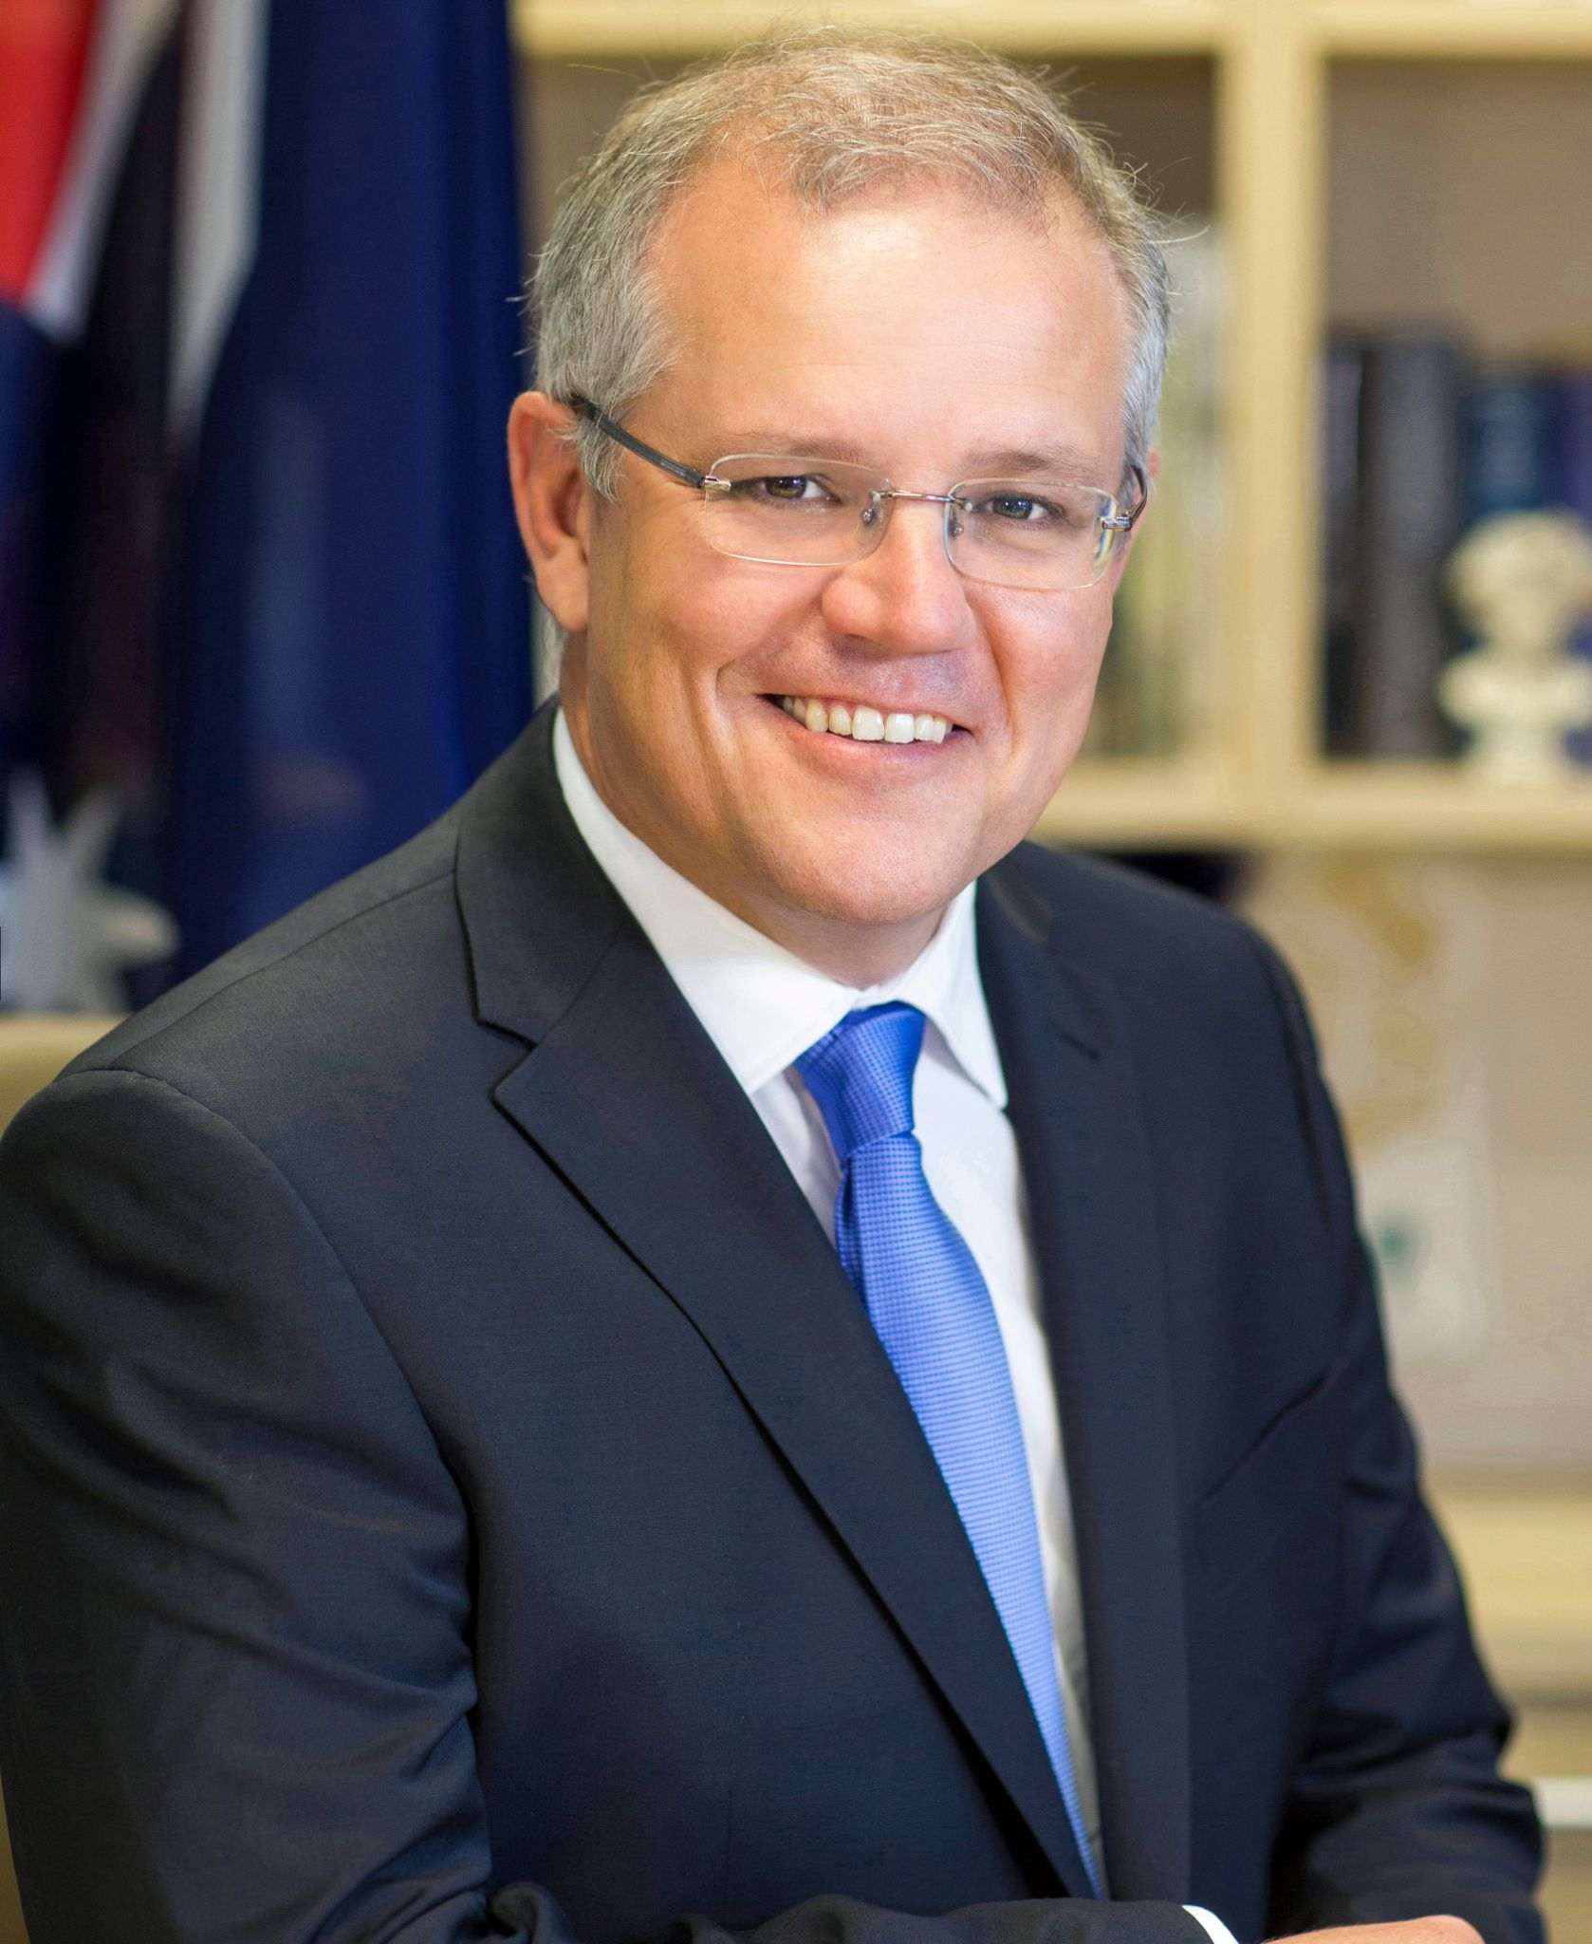
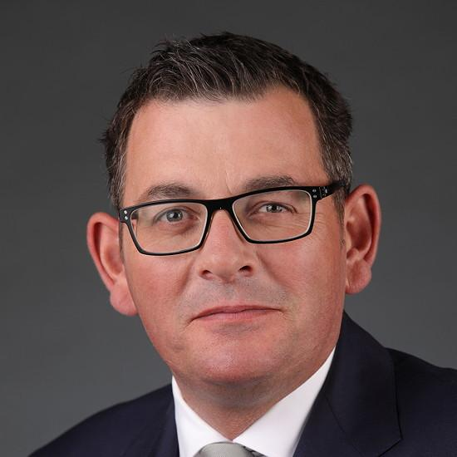
I am God
Elohim - creation, power
Ultimate control over all
Romans 13:1
Let everyone be subject to the governing authorities, for there is no authority except that which God has established. The authorities that exist have been established by God.

Slide 8
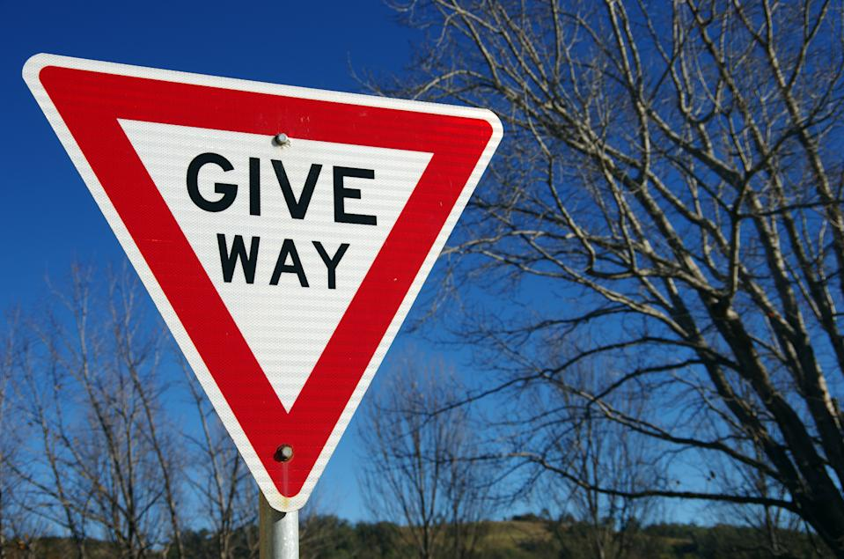
Know
Be aware of
Acknowledge, accept
Hand over authority to Him
Yield

Slide 9
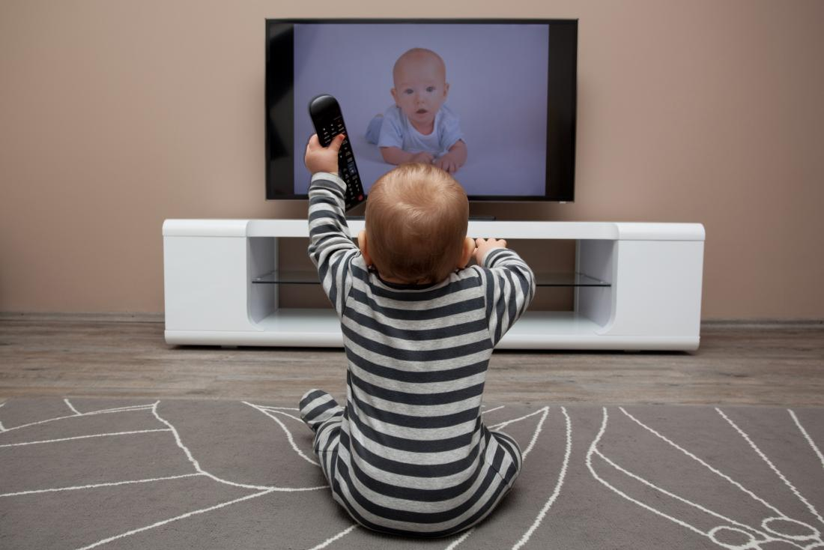
Be still

Slide 10
Be still
Cease activity
Mobile phone, Internet, Television, Work, Others
Sabbath
Quiet time

Slide 11
Psalm 46 New International Version
10 He says, “Be still, and know that I am God;
I will be exalted among the nations,
I will be exalted in the earth.”
11 The Lord Almighty is with us;
The God of Jacob is our fortress.

Slide 12
Be still and know that I am God
Be still and know that I am God
(He has ultimate authority over all)
Be still and know that I am God
(Yield to Him)
Be still and know that I am God
(Cease activity)

